Slide 1



Societal and Ethical Challenges in the Era of Big Data:
Exploring the emerging issues and opportunities of big data management and analytics
June 7, 2017 ; 15.30 – 17.00
Turin University, Turin, Italy

Slide 2


Exploring the Emerging Issues and Opportunities of Big Data Management and Analytics
Agenda Item | Speaker
Presentation of e-SIDES | Gabriella Cattaneo, Associate VP IDC European Government Consulting
Presentation of workshop objectives
Ethical and legal issues overview | Magdalena Jozwiak, Post Doctoral Researcher, eLAW Leiden University
Interactive session on ethical and legal issues
Presentation of results and discussion
Societal and economic issues overview | Michael Friedewald, Coordinator of ICT Research Fraunhofer ISI
Interactive session on societal and economic issues
Presentation of results and discussion
How to get involved with e-SIDES | Diala Ghanem, IDC European Government Consulting
Next steps and conclusions | Gabriella Cattaneo
Societal and Ethical Challenges in the Era of
Big Data
CEPE/Ethicomp 2017
Turin University, June 7 (15.30-17.00)

Slide 3

About e-SIDES

Slide 4


e-SIDES in a nutshell
Involve the complete value chain of big data stakeholders to reach a common vision for an ethically sound approach to processing big data
Improve the dialogue between data subjects and big data communities (industry, research, policy makers, regulators) and, thereby, to improve the confidence of citizens towards big data technologies and data markets.
e-SIDES Partnership
Coordinator
Communication
Community engagement
Technical partner for socio-economic research
Technical partner for legal and ethics-related research

Slide 5

e-SIDES key objectives
Identify, discuss and validate ethical and societal implications of privacy-preserving big data technologies
Liaise with big data community (researchers, business leaders, policy makers and society) through events
Provide ethical-legal and societal-economic advice to facilitate responsible research and innovation on big data technologies
Provide collective community position paper with recommendations for responsible research and innovation on big data

Slide 6

Workshop: Societal and Ethical Challenges in the Era
of Big Data

Slide 7


Workshop objectives
Validate results and collect your inputs
Present our initial work
Introduce e-SIDES

Slide 8
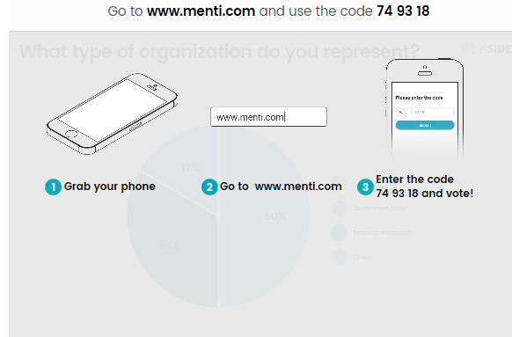
How to interact

Slide 9
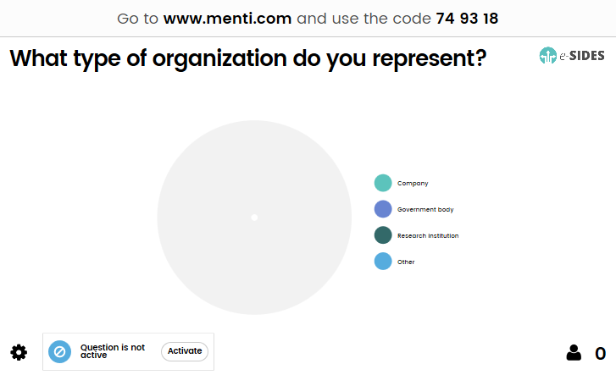
2 Min

Slide 10
Ethical and Legal Issues Overview
Magdalena Jozwiak, Faculty of Law, Leiden University

Slide 11
The current legal paradigm and its discontents
Different fundamental rights at stakes
Data protection as THE regulatory tool
Place for competition law and consumer protection

Slide 12
Problems with data protection
Practical limitations

Slide 13
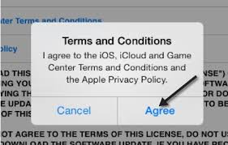

Slide 14
Problems with data protection
Practical limitations
Entrenched business models

Slide 15
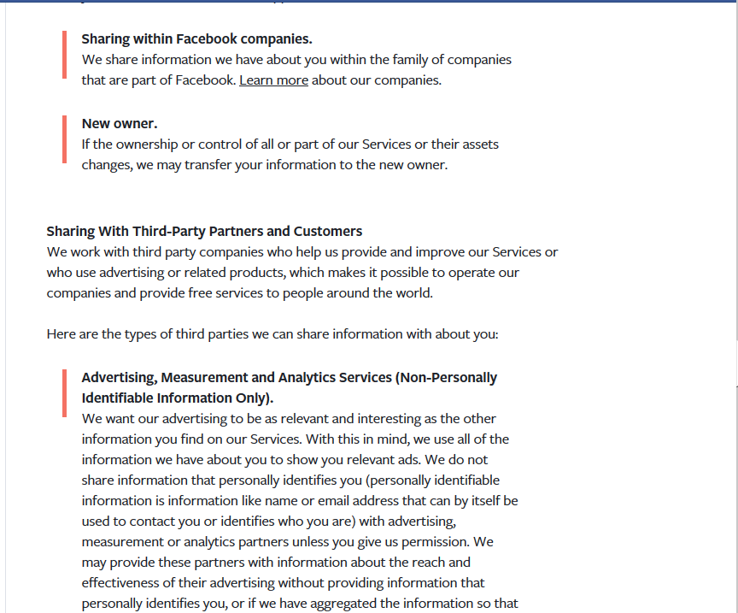

Slide 16
Problems with data protection
Practical limitations
Entrenched business models
Power assymetry, the problem of ‘bigness’

Slide 17
Problems with data protection
Practical limitations
Entrenched business models
Power assymetry, the problem of ‘bigness’
Limits of the fundamental rights framework

Slide 18
Going back to the sources
What is the rationale for rights’ protection?
Mapping the ethical issues at stake in:
gathering the data, making it big
processing the data (data analytics and decision making based on algorythms)

Slide 19
Issues for discussion
Legal aspects
Informed consent Purpose limitation Sensitive data Harm of processing

Slide 20
Ethical aspects
Solidarity (e.g. insurance individualization, society segmentation) Trust (e.g. dependence on algorythmic decisions) Autonomy (e.g. surveillence, filter bubbles, butlers, nudges) Bias (e.g. leading to discrimination of all sorts) Opacity (e.g. machine learning solutions) Moral responsibility

Slide 21

Interactive Session on Ethical and Legal Issues
Magdalena Jozwiak, eLAW

Slide 22
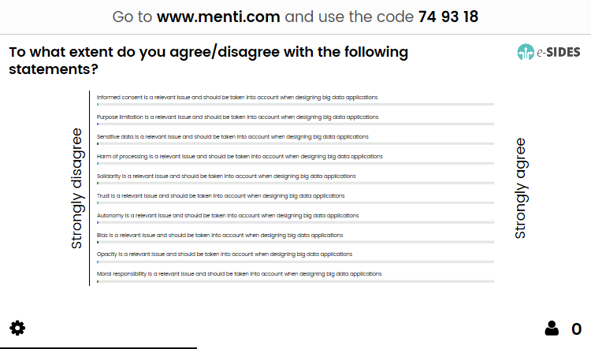
5
15 mins

Slide 23
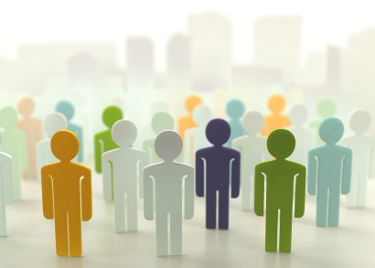
Societal and Economic Issues Overview
Michael Friedewald, ISI

Slide 24







Sources
FP7 and H2020 projects assessing impacts of different (big data related) technologies
BIG
CANVAS
CAPITAL
CLARUS
Coco Cloud
CONSENT
CRISP
DwB
ENDORSE
ENFORCE
Inter-Trust
SIAM
Socialising Big Data
SURVEILLE
SysSec

Slide 25
Unequal access
Not everybody or every organization is in the same starting position with respect to big data
The digital divide, for instance, refers to inequalities between those who have computers and online access, and those who don‘t
Access to contact data, a privacy policy or information about data collection, processing and sharing depends on capabilities
Inequalities with respect to the potential benefits from big data also exist between organizations of different industries, sizes and regional contexts
Example
Online policies on websites typically require a through legal and technological understanding to be fully understood, if they are found at all
Notes:
WAS INEQUALITY
The diversity of people and organizations in terms of capabilities and access to technology
http://www.cio.com/article/2437725/security-privacy/online-privacy-policies-hard-to-find--understand.html

Slide 26
Normalization
People are put into categories whose characteristics are determined by what is most common and thus expected to be most likely
Filter bubbles result when an algorithm selectively guesses what information somebody wants to see based on information about the individual as well as other similar individuals
The breadth of choices is restricted and pluralism pushed back
Normalization also happens on an organizational level but seems to be less critical
Example
Recommendations for products in online shops such as Amazon
Notes:
The reduction of people to a norm or standard
Limiting creativity

Slide 27
Discrimination
People or groups are treated differently depending on certain characteristics including age, disability, ethnicity or gender
Big data technologies to some extent allow concluding initially unknown characteristics from others in the same or other datasets
Discriminating people or groups might make economic sense and is difficult to be detected
Data or algorithms upon which people are discriminated may be incorrect or unreliable
Example
Predictive policing, no-fly lists, or personalized pricing are examples where discrimination in the context of big data becomes visible
Notes:
Unfair treatment of people or groups based on certain characteristics
Alternatives: fairness

Slide 28
Dependency
People and organizations depend on others collecting or processing data about or related to them, or providing access to data
Switching from one organization to another is often linked to high costs, if it is possible at all
For many types of data or data-related services, there is a limited number of providers and a considerable share of them is based outside the EU
Business practices as well as security measures can usually not be affected by externals
Organizations are also highly dependent on the data as well as the big data technologies they use
Example
Data-intensive organizations such as NHS hospitals in the UK had to stop operating after being attacked with ransomware
Notes:
The dependency of people from organizations and between organizations

Slide 29
Intrusiveness
Big data has integrated itself into nearly every part of people’s online and to some extent also in their offline experience
Data is stored for long periods of time and the potential to analyze the data or to integrate it with other data grow
General suspicion of public authorities or an insatiable appetite of organizations for ever more data infringe people’s freedom
The behavior of people including how they live, work and interact with each other is affected by intrusive big data applications
Example
The impact of the integration of big data and video surveillance is considered to have particular potential for being intrusive
CCTV, body cameras and drones are increasingly used without the consent of the people observed
Notes:
The intrusion into the privacy of people
https://www.theguardian.com/uk-news/2017/mar/14/public-faces-mass-invasion-of-privacy-as-big-data-and-surveillance-merge

Slide 30
Non-transparency
Algorithms are often like black boxes, they are not only opaque but also mostly unregulated and thus perceived as uncontestable
People and organizations cannot be sure who is collecting, processing, sharing which data
There are very limited opportunities to check if an organization has taken suitable measures to protect sensitive data
Law enforcement is often constrained by a lack of resources of public authorities
There is a lack of practical experience with respect to audits including privacy impact assessments
Example
Data subjects’ right to information often impossible to exercise
Right to information limited to data storage
Notes:
The lack of transparency for people
https://www.heise.de/newsticker/meldung/Datenschutz-EU-Studie-zeigt-Probleme-in-der-Praxis-2248265.html
Lack of

Slide 31
Abusiveness
Data as well as big data technologies may be used for illegal purposes or for purposes that fall into a legal grey zone
It is difficult to check the validity of results of data analyses if they look plausible
Data or algorithms can be manipulated in order to reach desired results
The border between data use and abuse is blurry at times
Example
Data collected to remove security flaws may be used by criminals to take over vulnerable systems
Notes:
The potential for abuse of data and technologies
https://blog.kaspersky.com/scary-big-data/9626/

Slide 32
Unfair competition
Small group of data collectors and data collectors offering platforms for data and applications
Dominance of US actors
Value chains dependent on non-European elements
Network and lock-in effects
New “natural” monopolies
Large differences in competitive conditions
Asymmetry of market power
Accumulated advantage (Matthew effect) for those holding data
High barriers for market entry
Power to manipulate markets
Example
EU Commission has led several competition cases against Google’s dominance in several markets (e.g. online advertising)
Notes:
Focus companies

Slide 33
Labor market transition
Application of big data analytics impacts the quality and quantity of (mainly) intellectual work
Big data analytics allows the automation of routine tasks
Uncertain: Job loss vs. compensation of lost jobs
Big data analytics need different labour qualifications
Uncertain: Upskilling vs. disqualification vs. polarisation
Example
“LawTech” to automate the search and classification of case law
Similar effect: “FinTech”
Notes:
Adverse changes on the labor market

Slide 34
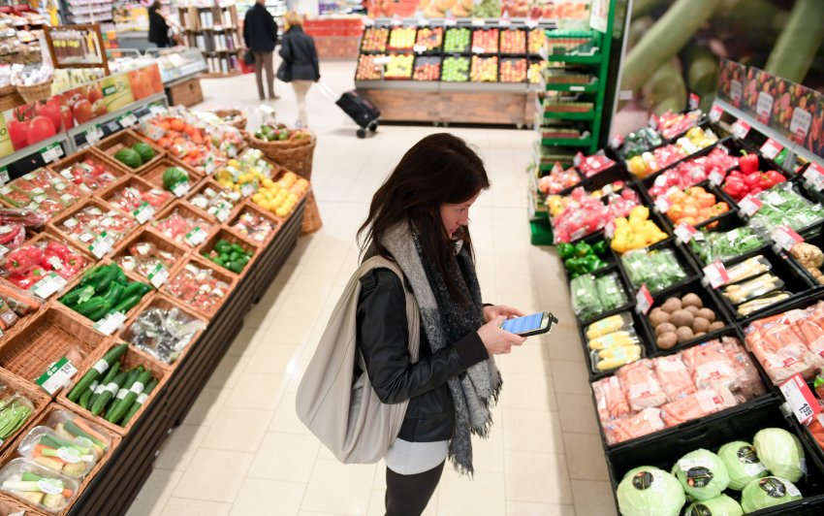
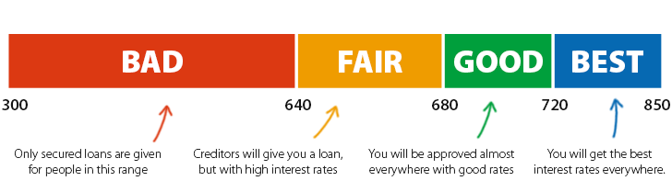
Information and power asymmetry
Consideration of consumer protection rights and interests
User can not negotiate for what price (in money or data) they use online services
Re-use of data almost always does not include a sharing of benefit with the data subject
Data (re-)use is often not in the interest of the data subject (e.g. credit scoring, targeted advertising, …)
Example
Many online services can only be used after providing requested data (take-it-or-leave-it)
Super markets using video data w/ face recognition to classify and “guide” customers
Notes:
Imbalances of power in transactions
– focus customers

Slide 35
Interactive Session on Societal and Economic Issues
Michael Friedewald, ISI

Slide 36

5 mins
15

Slide 37

Next Steps and Conclusions

Slide 38
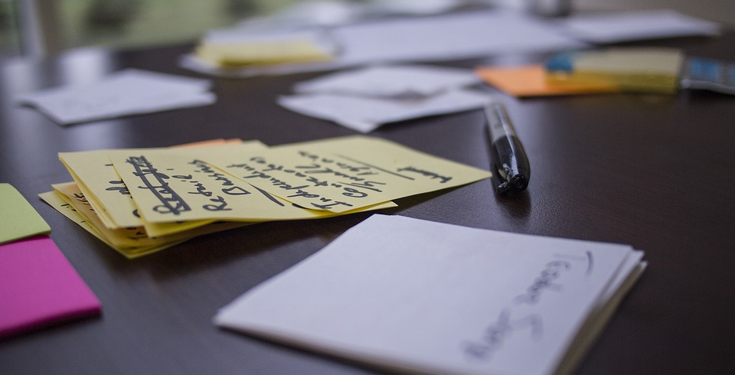
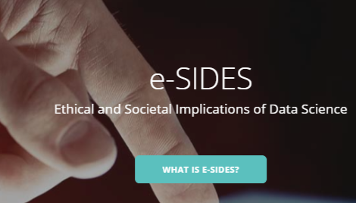
Next e-SIDES event: ICE/IEEE Conference, June 28 Madeira
Next e-SIDES Report presenting the issues in August 2017
Online community initiatives: e-sides.eu
Attend our following conferences, workshops and webinars
Get access to relevant, novel and continually updated content
Contribute to our online community paper on website at www.e-sides.eu

Slide 39




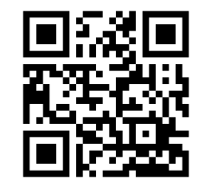
@eSIDES_eu
eSIDES_eu
e-SIDES
www.e-sides.eu
info@e-sides.eu

Slide 40


